Slide 1
Kubernetes Implementation into HPC
Livermore Computing
Jessica Gomes, Jonathan Victorino, Harry Yee
HPC CEA Interns
August 10, 2017

Slide 2

Meet Team Kubes
Harry Yee
UCLA
Jessica Gomes
University of Illinois at Urbana-Champaign
Jonathan Victorino
Stanford University

Slide 3

Objectives
Setup a Kubernetes cluster using Docker containers
Run LINPACK benchmark tests comparing Kubernetes and bare metal cluster
Determine performance overhead of running the cluster in Kubernetes
Automate Kubernetes builds and deployments using Puppet
Notes:
Harry

Slide 4
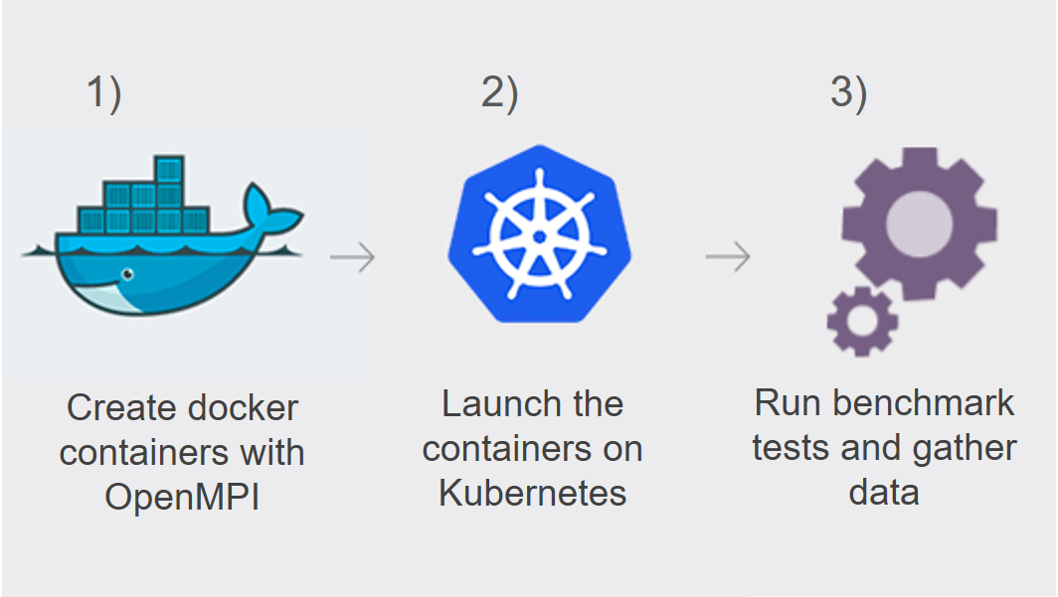
Our Project
Notes:
Harry
-A general overview of our project

Slide 5

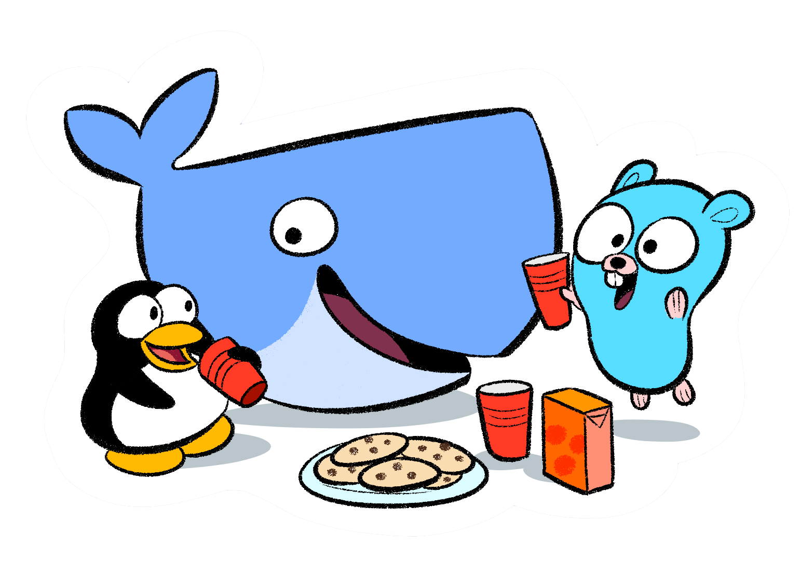
Docker
World’s leading software container platform
Container: stand-alone package that includes everything needed to run it
Easily create images for containers using Dockerfiles
Use Docker Hub to automatically update the containers
Notes:
Jonathan
Main uses of Docker: eliminate “works on my machine” problems when collaborating on code, run and manage apps side-by-side in isolated containers to get better compute density, and build agile software delivery pipelines to ship new features faster.
-A container image is a lightweight, stand-alone, executable package of a piece of software that includes everything needed to run it: code, runtime, system tools, system libraries, settings.
-Containerized software will always run the same, regardless of the environment.
And you can create images for these containers easily using dockerfiles.
These dockerfiles are then stored in docker hub
Which is a cloud-based registry service which allows you to link to code repositories and build your images and test them.
So as soon as you make a change on your github rep, Dockerhub automatically updates the container.

Slide 6

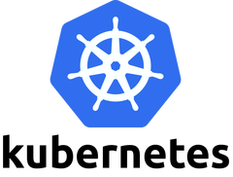





What is Kubernetes?
Open-source system for automating deployment, scaling, and management of containerized applications
Schedule and deploy any number of Docker container replicas onto a node cluster
Notes:
Harry
Kubernetes is
Portable: public, private, hybrid, multi-cloud
Extensible: modular, pluggable, hookable, composable
Self-healing: auto-placement, auto-restart, auto-replication, auto-scaling

Slide 7
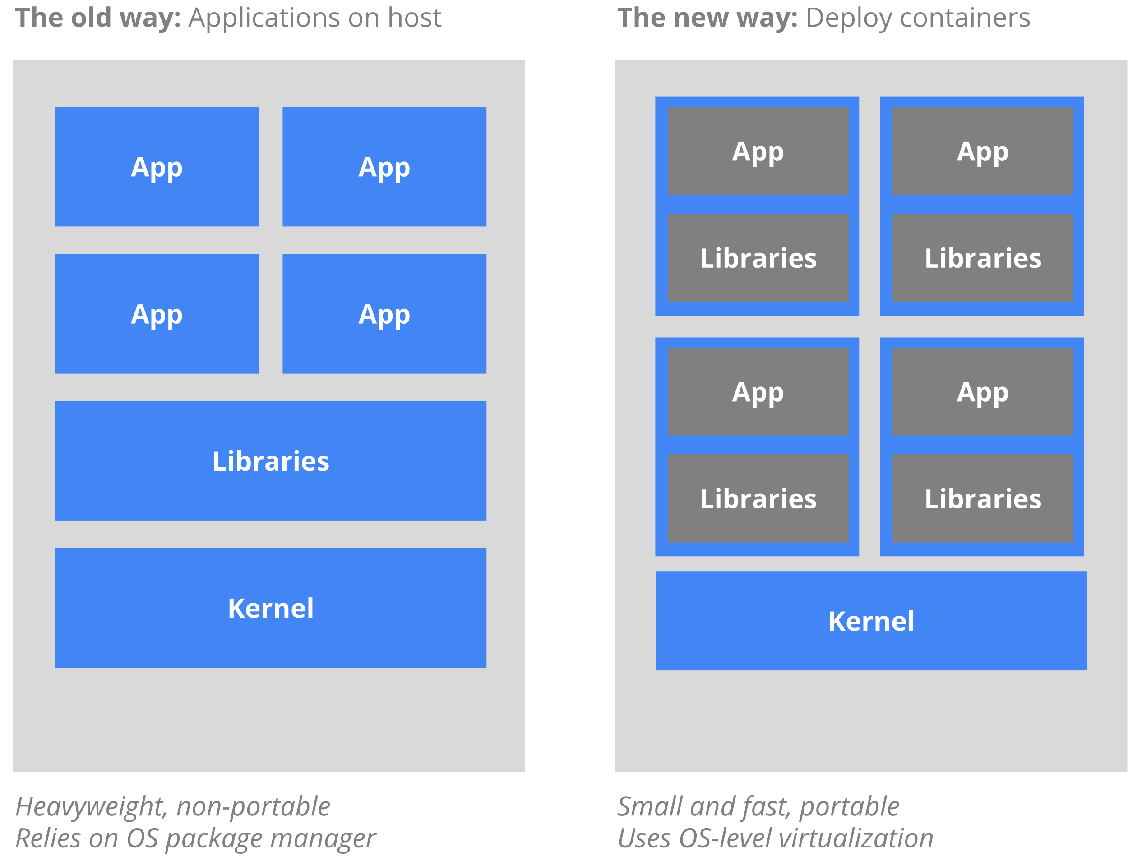
Kubernetes Container Visualization
Notes:
Harry

Slide 8
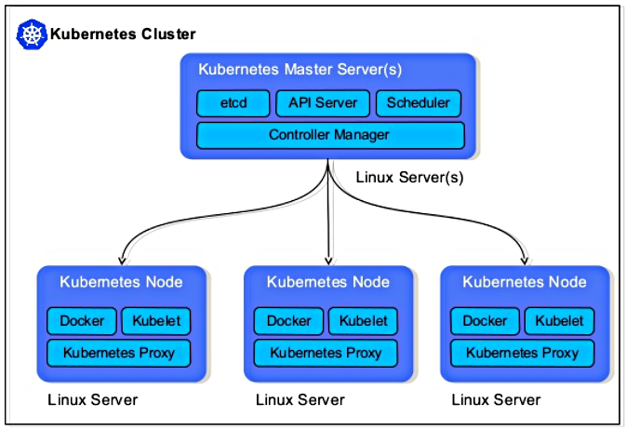
Kubernetes Architectural Overview
Notes:
Jessica
As we can see here, there is a single master node which all the worker nodes are connected to
In the way we implemented Kubernetes, our Master node is on the management node of the cluster.
etcd is used as Kubernetes’ storage unit, all cluster data is stored there
The Kubernetes API server validates and configures data for the api objects which include pods, services, replication controllers and more
The Scheduler impacts availability, performance, and capacity
The Kube Controller Manager is a daemon that watches the state of the cluster and makes changes to move the current state towards the desired state
Moving onto the worker nodes, they are on the compute nodes of the cluster
As previously mentioned, we used Docker containers for our Kubernetes worker nodes. They all contained Docker, Kubelet, and the Kubernetes Proxy
Kubelet is the component that runs on all of the machines in the cluster and does things like starting pods and containers
The Kubernetes Proxy runs on each node and reflects services defined in the Kubernetes API
With all these components, this system is a functional alternative to running a cluster in the bare metal method

Slide 9

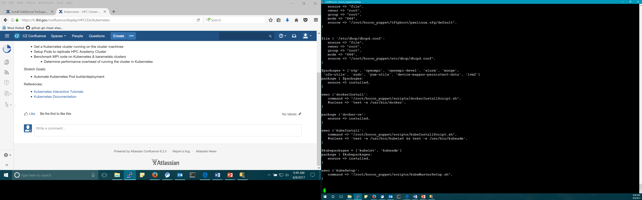
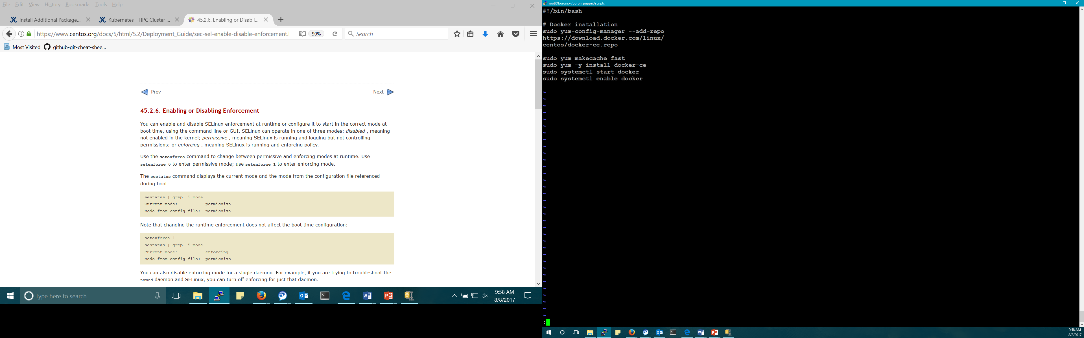
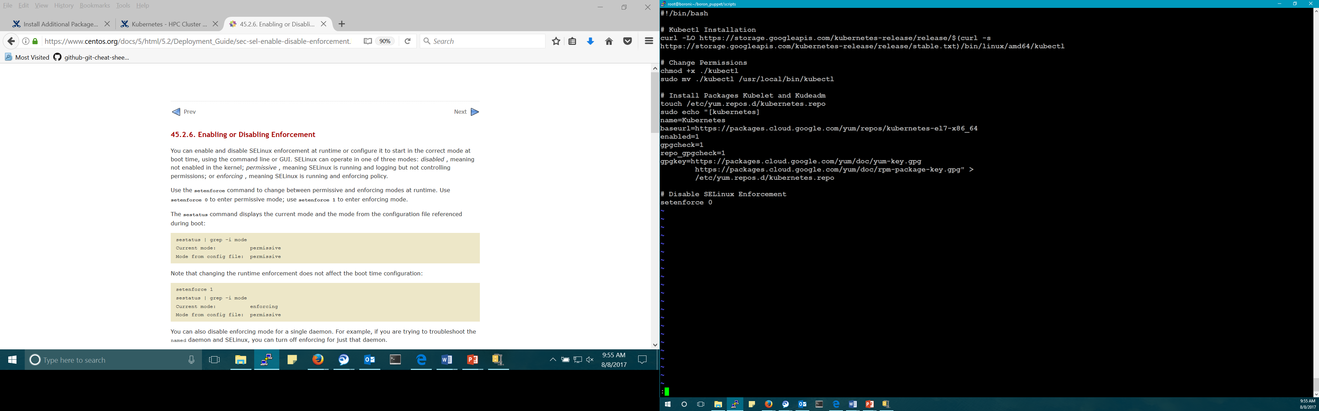
Installation Process
Docker Installation Script
Kubernetes Packages Installation Script
Puppet Manifest File
Notes:
Jonathan
So to get kubernetes on our cluster we decided to use puppet.
Puppet is a configuration management software tool that allows for control over the exact configuration of many different nodes, and enabled us to easily setup kubernetes across multiple nodes.
We used puppet to make sure the correct packages were installed and then run scripts to finish the setup of docker and kubernetes. We wanted it to also automatically setup the master and worker nodes, but we had to do this manually because our script wouldn’t output the join token.

Slide 10
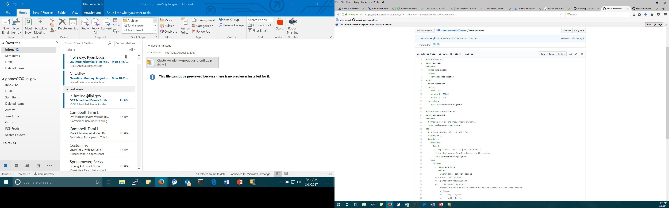
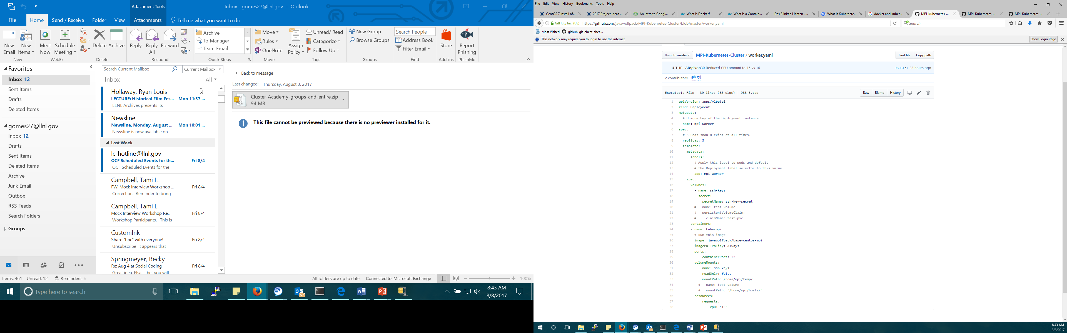
.yaml Files
Notes:
Jessica
Yaml gets translated to JSON format
MASTER.YAML
An issue that we ran into while setting up our cluster in Kubernetes was a CrashLoopBackOff error and this kept occurring because the containers we were creating kept dying
This happened because Kubernetes pods are mortal; in other words, when they die they are not resurrected.
Even though each pod get its own IP address, even that is not stable and reliable over time
In order to keep track of the pods that provide functionality to other pods which in our case was the ssh capability, we needed to create a service
This is why we see two “kinds” in our master.yaml – one is a service and one is a deployment
In order to completely fix this issue, we also had to run ssh as a daemon so it would keep the container alive until the container was manually killed by us
WORKER.YAML
As we can see in this yaml file, there is only one kind and that is Deployment
It also specifies how many replicas, labels, and other things which are pertinent for deploying a worker pod that can communicate with the master

Slide 11
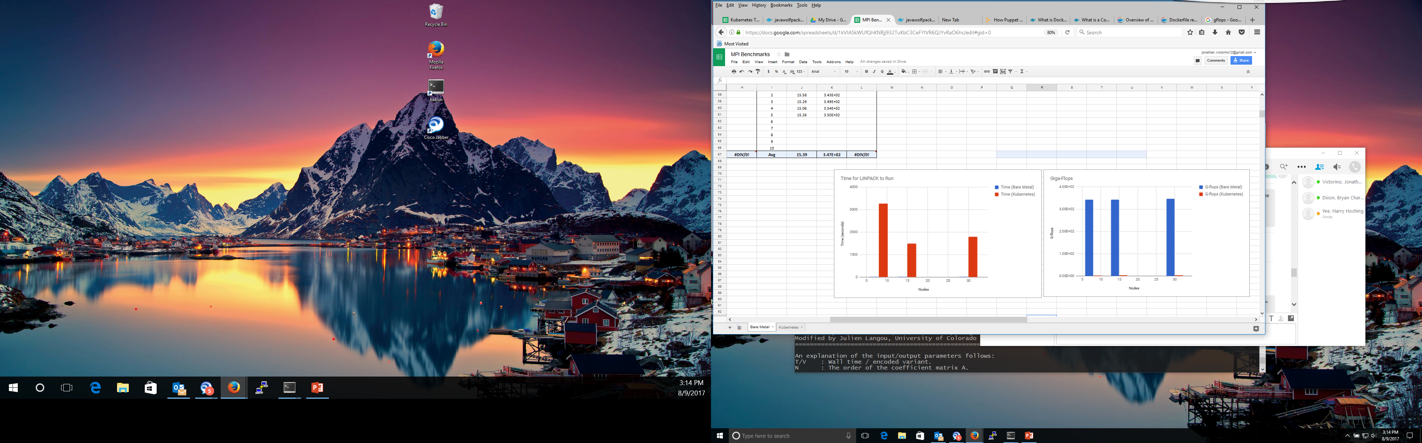
LINPACK Benchmarks
 | Time (seconds) | G-flops
Bare Metal | 15.39 | 3.47E+02
Kubernetes | 1796.654 | 2.99E+00
Notes:
Jonathan
Because our goal was to compare the difference between the bare metal cluster and a kubernetes cluster, we used LINPACK to compare the two. From our preliminary results we’ve found that on average the bare metal had 480 g-flops and took around 11 sec while the kubernetes cluster had 4 G-flops and took 1480 sec.

Slide 12
Conclusion
Kubernetes
Large performance overhead on clusters
Extra setup steps
Not ideal for HPC
Use bare metal cluster
After further testing, the bottleneck was found to be due to a networking issue
Time and G-flops were comparable for containers running on the same node to the bare metal configuration
Notes:
Jonathan

Slide 13

Future Plans
Use Puppet to automate builds and deployments
Automatically ssh from worker to master
Run more Benchmark tests on Kubernetes cluster
Find out how to fix the bottleneck and improve communication between containers
Notes:
Jessica
We’re not using the remote memory access for MPI, we are using the Kubernetes memory not the cluster memory

